Slide 1
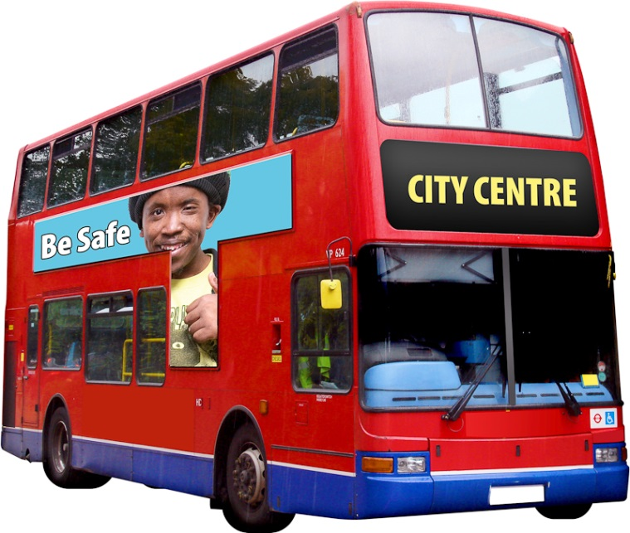
Staying Safe on the bus

Slide 2
Introduction
Bus safety is very important.
There are lots things that you can do to be safer when on the bus.

Slide 3
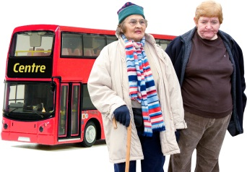
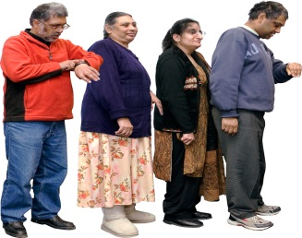
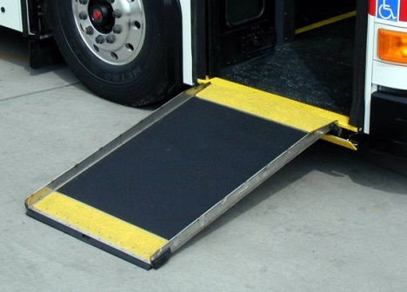
Getting on the bus safely
You should be very careful when getting on the bus. Hold on in case the driver pulls away quickly!
Don’t push in the queue and watch out for other people pushing you.
Watch the step, don’t trip over it!
If you have difficulties walking , the driver should help you by lowering the bus and pulling out the ramp.

Slide 4
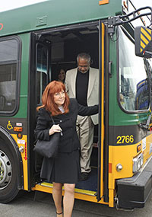
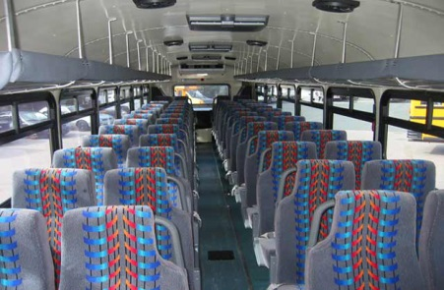
Getting off the bus safely
Ring the bell once. Stay in your seat until the bus stops.
Be careful when stepping off the bus, watch the step!
Watch out for people or objects such as bags in your way when walking off the bus.

Slide 5
What should you do to get on the bus safely?
Hold on in case the driver pulls away fast
Push through the queue to get to the front
Be careful when stepping on the bus
Stay standing when there are free seats

Slide 6
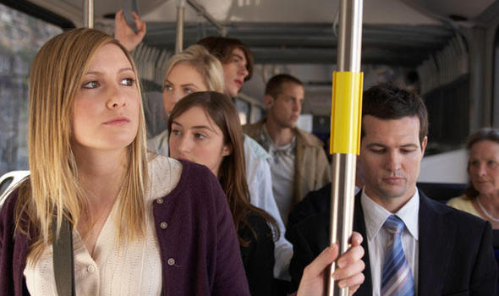
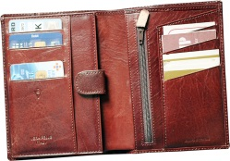
If you have to stand up…
Hold on tight if you have to stand up. Only stand if there is nowhere to sit.
Keep an eye on your bags and valuable belongings – phones, cards, wallets, purses, keys…
Make sure your bag is zipped up and keep hold of it.

Slide 7
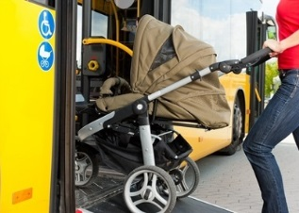
Disabled people and the elderly
Allow these people to sit on the front of the bus:
People who can’t walk very well or are in a wheelchair
Elderly people
Parents with babies or pushchairs
As of 2017, Wheelchair users now have priority over people with prams.

Slide 8
What should you do if you have to stand up?
Stand in a crowd at the front of the bus
Hold on tight while keeping an eye on your belongings
Dance to your music

Slide 9
Which of these people has more priority to sit at the front of the bus?
Wheelchair users
Elderly people
Parents with babies or toddlers in prams
Young people

Slide 10
What should I take with me?
Before you go out, think about what you’re going out for and decide what you will need.
Always take your:
Mobile phone.
Bus pass
Wallet/purse with money
House keys

Slide 11
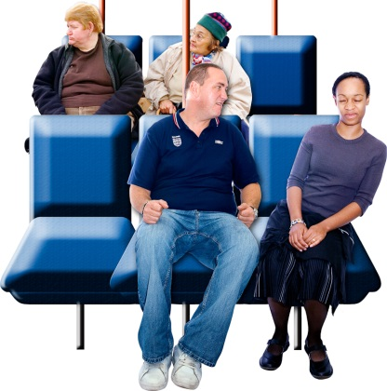
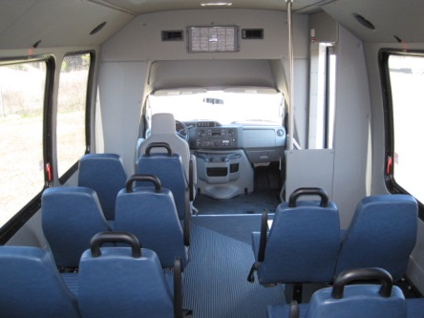
Other People on the bus
Don’t talk to strangers on the bus. Be aware of the dangers if a stranger starts talking to you.
Only talk to people you know. If you are traveling with friends or family, this is OK.
Sit near the front of the bus if you feel worried.
If anyone bullies or abuses you, always tell the driver!

Slide 12
What should you always take with you?
Mobile phone
Fizzy drinks
Cats and dogs
Wallet or purse

Slide 13
Which of these should you not do on the bus?
Talk to strangers
Give them money
Travel with friends
Play music very loudly
Sit at the front

Slide 14
Thank you for listening!

