Slide 1




Road Safety
Road Safety
How to keep yourself (and others) Safe when out and about

Slide 2
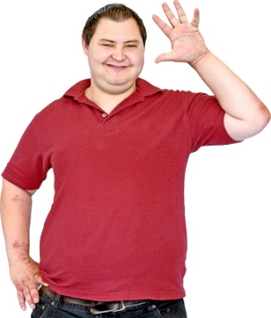

Introduction
Introductions – My name is…
Today we have a presentation we would like to talk to you about.
This is about Road Safety

Slide 3
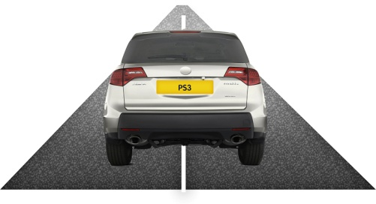
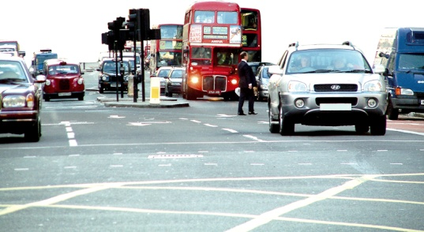
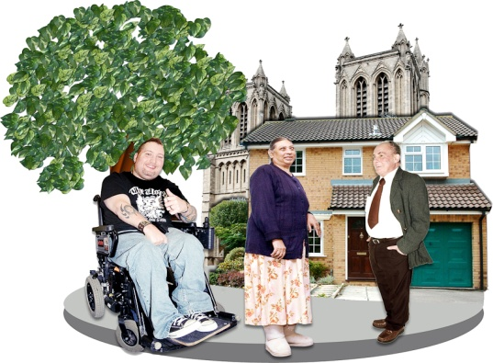
What is road safety?
When you know how to cross the road safely.
When you know how to stay safe when there is lots of traffic.
When you are aware of the dangers that you might face when you are out and about.

Slide 4
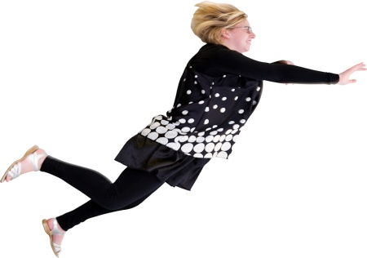
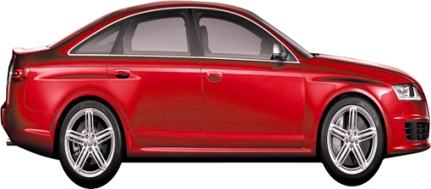
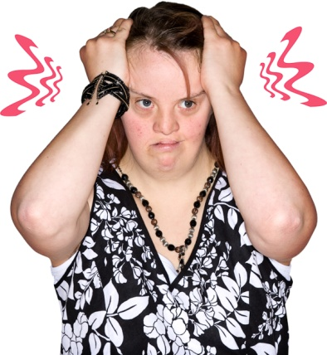
Why do we need to be safe?
So we don’t get hurt.
To make it safe for drivers, cyclists and any other road users.
To make your journey less stressful for you and other road users.

Slide 5
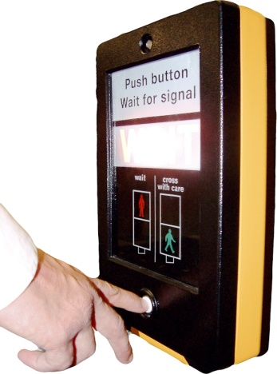
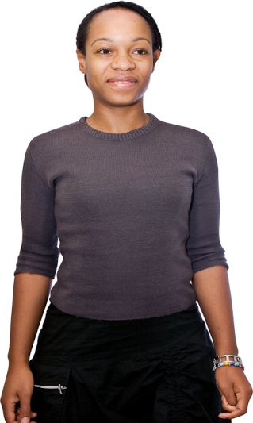
How can you stay safe?
When you want to cross the road, always make sure you cross at a crossing.
Crossings are really important and keep everybody safe - if they are used in the right way.

Slide 6
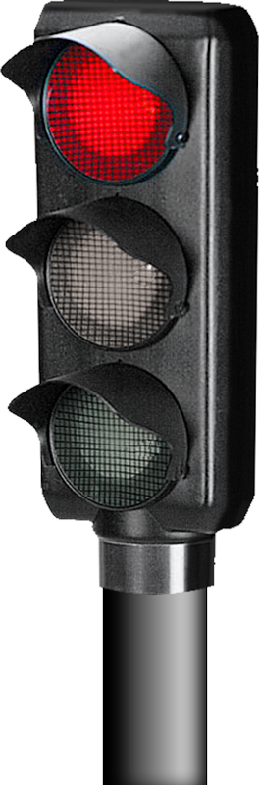
What are the different crossings?
There are four different types of crossings that you can use:
Pelican
Puffin
Toucan
Zebra

Slide 7
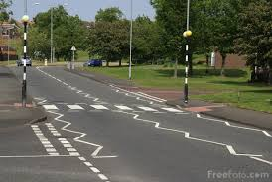
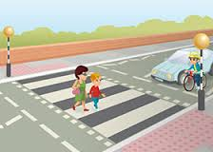
What do the crossings do
Zebra Crossing
A zebra crossing has black and white lines on the road and two yellow lights
If a car sees you at a zebra crossing, they must stop, but always wait until the cars have come to a stop before you cross

Slide 8
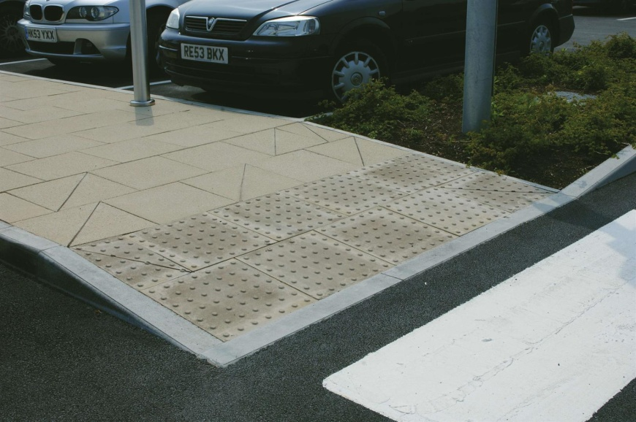
Remember !!!
Whenever there is a crossing to use, or an island between the roads, the path will lower and there will be bumps on the path called tactile paving. This will help people who are blind or have poor eyesight to know where to cross safely.

Slide 9
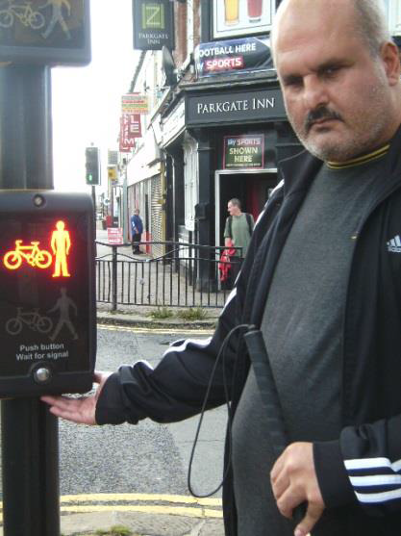
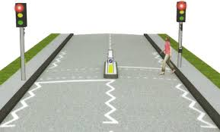
Pelican Crossing
A pelican crossing has traffic lights that will stop traffic before you can cross. When it is not safe to cross the red man will light up. When it is safe to cross the green man will show.
For people who are blind or have poor eyesight at this crossing there is a cone shaped handle under the traffic light button, turn this round until it stops, when it starts spinning it is safe to cross the road.

Slide 10
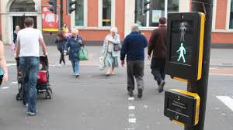
Puffin Crossing
A puffin crossing uses sensors to stop traffic. This means that when people walk up to the crossing the traffic lights will warn drivers to stop and let pedestrians cross.

Slide 11
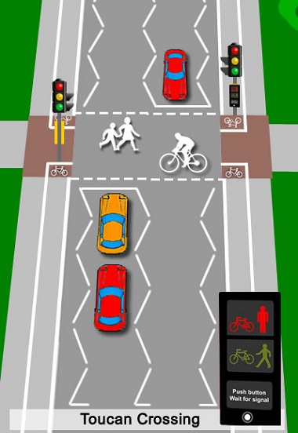
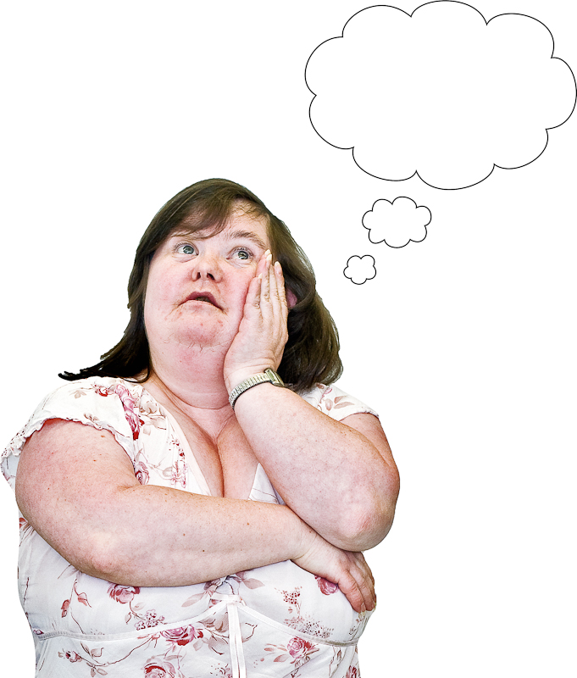
Toucan Crossing
A Toucan crossing is a lot like a pelican crossing. The difference is at a Toucan crossing cyclists can cross the road with you at the same time.
A way to remember a toucan crossing, is both pedestrians and cyclists can cross together, meaning two-can cross at the same time.

Slide 12
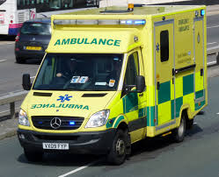
Remember !!!
Always be aware of emergency services.
No matter what crossing you choose to cross the road, emergency services will not stop for you if the sirens are on.
Always take extra care and wait until they have passed.
To be safe you must look again before crossing the road.

Slide 13

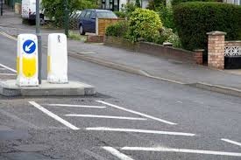
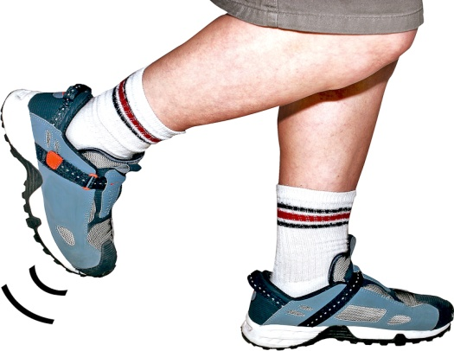
What do you do when there isn't a crossing, or it does not work.
Sometimes there isn't a crossing or the crossing doesn’t work, you must take extra time to look before crossing.
There may be a island in the middle which you can wait on if you can only cross half the road.
You may want to cross quicker, but be careful when doing so as its still dangerous.

Slide 14

How can we help to stay safe, especially in bad weather ?
It is always a good idea to stay in well lit areas, so people driving can see you.
However, make sure you are not to close to the edge of the road, in case a car needs to move onto a path for emergency services passing.

Slide 15
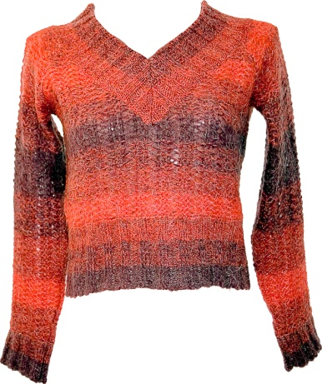
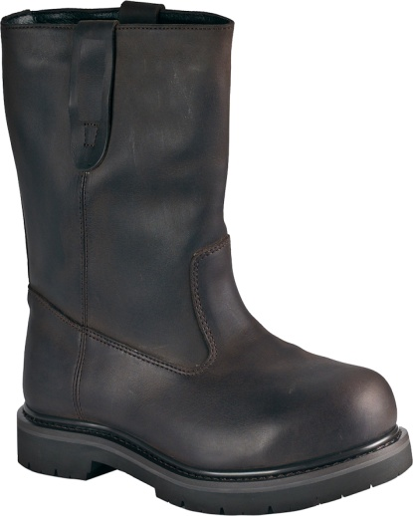
Weather warnings
If the weather is cold you must wear warm, sensible clothing, such like a coat or taking an umbrella with you.
You should always wear good footwear, they should have good grip and keep your feet warm and comfortable.

Slide 16
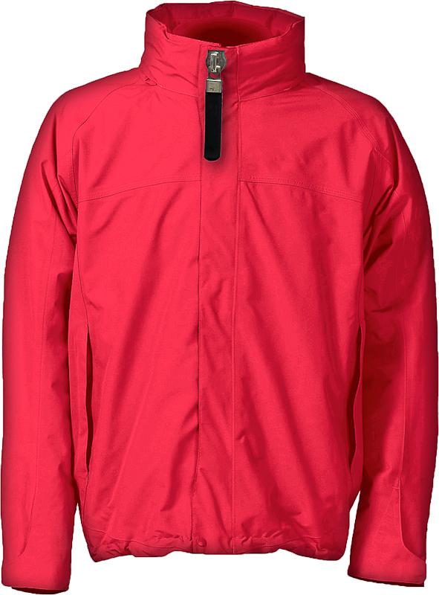
Remember
Wearing something bright is a good idea as drivers are able to spot you clearly.
But wearing a hat, sunglasses or headphones are not ok as they can make it hard to hear or see traffic.

Slide 17

Safety Circles
We have brought with us some blank safety circles, and our workbook.
Complete these in your own time, they are a good resource to use that help you to think about how to keep safe when out and about.
Think about the people you know who will keep you safe when out and about.

Slide 18

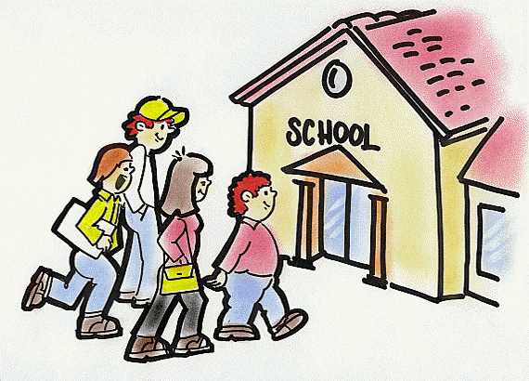

How can we make everyone safe?
Advertise
(posters, TV, radio)
Training in school and work
Easy read leaflets

Slide 19
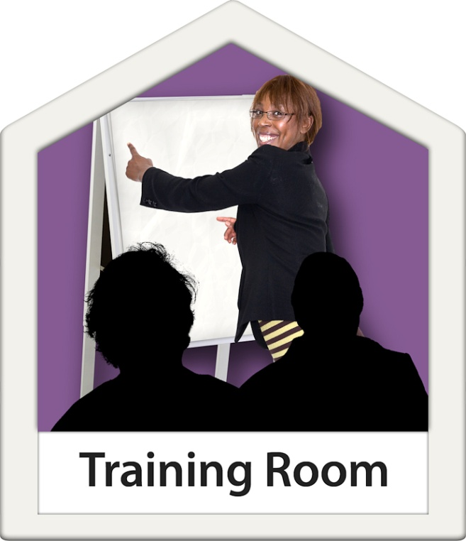
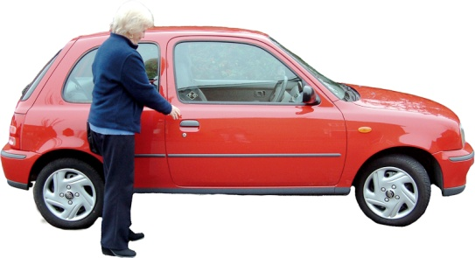
What can the councils do?
Tell everyone more about road safety.
Make it so everyone gets training on road safety.
More bumps and cameras in residential areas.
Make sure roads are safer.

Slide 20
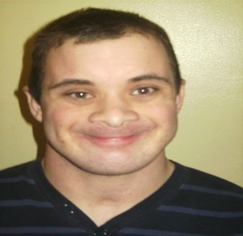
Sarah
Door to door travelling
Jonno
Myself
999
Jonno
Mum
Social
worker
Sister
Mum
Not fully Independent
sister
Wayne
Hayley
Hayley
Dad
Mum
Needs more training crossing the roads
Wayne
My O.T
Matt
Dad
Jo from RCAT college
Dad
Keeping safe cards
Notes:
Here is an example of a safety circle for one of our self-advocates. This person is a good example of how safety circles work. This self-advocate one day turned up at work, but one of the buildings was closed. He rang one of the other offices to tell them, and waited in a safe area to be picked up. He

Slide 21
Key
this circle is about personal safety. For example, this could be about your health or what you need support with.
people who can keep you safe while you are out and about, including crossing roads.
people who keep you safe on public transport
people who you can ring in case of emergencies

Slide 22
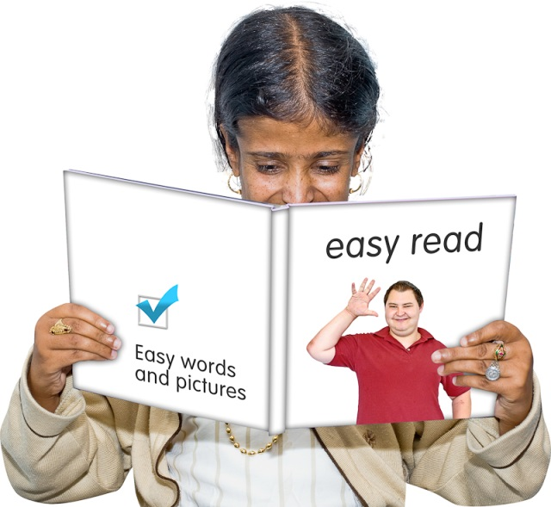
Our workbook
Our workbook talks about how to keep safe when out and about.
It also has an easy to use exercise that people who need support can practice showing how to keep safe.
As you have probably noticed, the book is very accessible, with pictures and simple text.

Slide 23


Thank you very much for listening!

