Slide 1
South Yorkshire Fire and Rescue
Fire and Health Conference
16th February 2016
Wayne Goddard
Head of Strategy and Delivery for Dementia in Doncaster
A Dementia Case Study

Slide 2
Disseminating Innovation

Slide 3
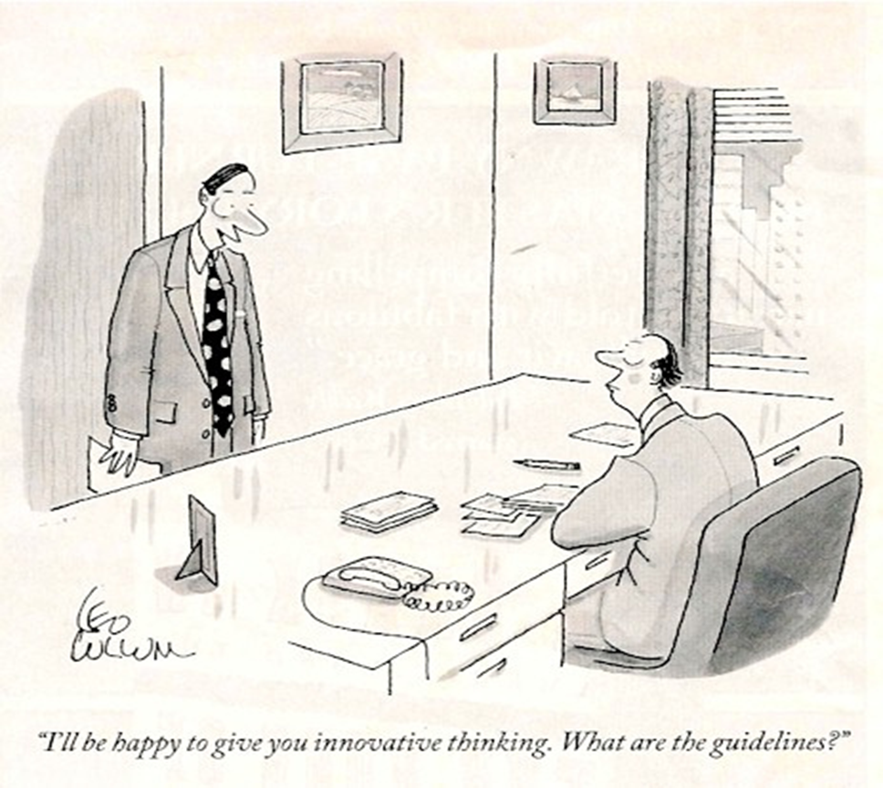

Slide 5
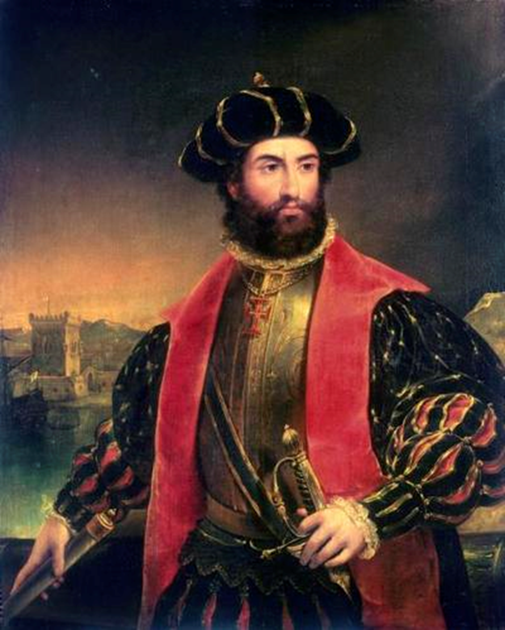

Slide 6
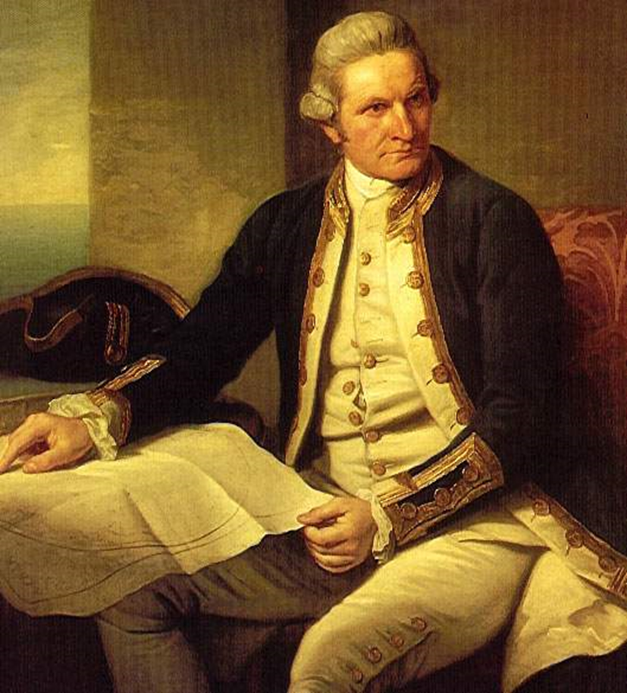

Slide 7
So how does this relate to SYFR?
The Service has grasped opportunities, learnt from others and applied this through innovative action.

Slide 8
The Opportunities
The service is more than just fighting fires
The service has a respected and strong brand
Key partners in town and city governance
Linked closely to health – proactive and reactive.
Linked closely to vulnerable groups
People with dementia are extremely vulnerable.

Slide 9
The Learning
50% of fires involve older people
Dementia is synonymous with age
Dementia is synonymous with risk
Managing that risk is not just down to the service.
Managing risk is cost effective.
Influencing partners and engaging with communities is key.

Slide 10
The Action
The service has a seat on the HWB.
Dementia is a HWB priority thus the service has influenced debate, plans and action.
Been pro active in managing risk
Grasped the opportunities of working with partners and communities. Alzheimer’s Society.
Funding Dementia Action Alliance work across SY through the SSCR.
The service is a Dementia Champion with many personnel being Dementia Friends or Dementia Friends Champions.

Slide 11
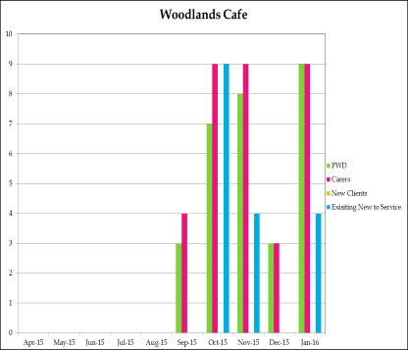
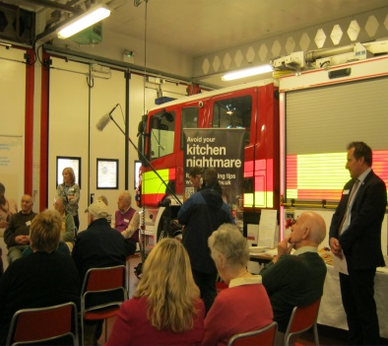
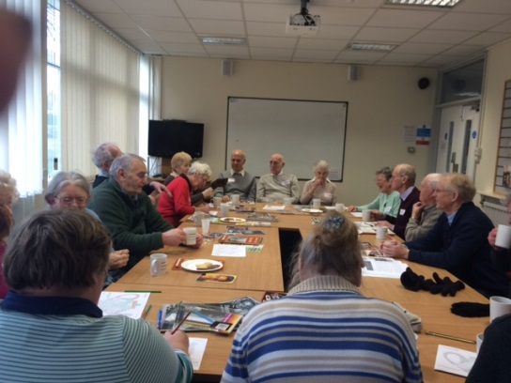
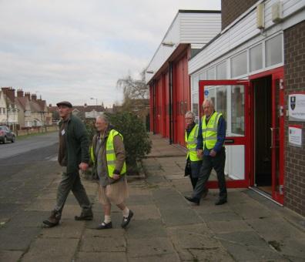
The Doncaster Action
The Adwick Station Memory Cafe
The Woodlands café at the Adwick fire station started in Sept 2015.
Activities are : Walking group, games e.g. cards domino and we are going to do a gardening group in the summer.
The café runs monthly. Attendance has been good with 18 people with dementia and there carers attending in January. (capacity 20)
Peter Jones Partnership officer Prevention & Protection community safety leads the walk with volunteers from the SYFR.
Fire officers drop in through the duration of the café to chat with people with dementia and there carers.

Slide 12
The Doncaster Action
DDAA working in partnership with the other Action Alliances across SY has secured funding through SSCR to embed fire safety messages within organisations who are Alliance members.
This is a collaborative approach to promote fire and community safety to people who are living with dementia and their carers.
A combined Alliance membership across SY of 300 inc public sector, retail, voluntary sector, private companies and faith communities provides excellent reach.
2 year project will build on current SYFR public awareness initiatives.
Fire Safety and Community Safety will also feature in the work required for the SY areas to demonstrate they are Dementia Friendly.
In Doncaster, a local Project Coordinator works with individuals and organisations to raise awareness and promote fire safety. This inc making referrals to the SYFR service for home safety visits and developing relevant messages as part of the DF awareness sessions.

Slide 13
Finally
A big thankyou from me and the people with dementia and their families.
Keep up the good work and lets never catch scurvey!

