Slide 1
Better Than The Cure: Preventing More Than Fires
Better Than The Cure: Preventing More than Fires
Geoff Harris
Chief Fire Officer’s Association

Slide 2
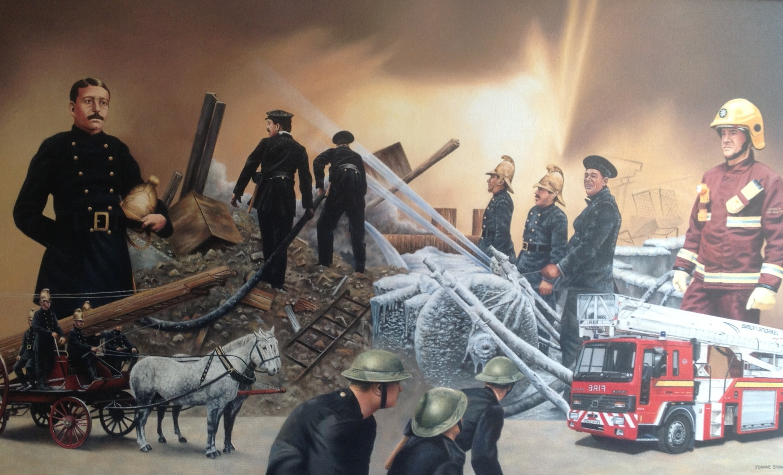
Firefighting in the Twentieth Century

Slide 3
Drivers for Change
1995 – ‘In The Line Of Fire’
1997 – ‘Safe as Houses’
1998 – ‘Out Of The Line Of Fire’
2002 – ‘IRFS, The Future of the Fire Service: reducing risk, saving lives’ (Bain Review)
2002/03 – ‘Industrial dispute’
2004 – ‘Fire and Rescue Services Act’
  Duty to promote Fire Safety
2013 – The Knight Review
2014 – Five Year Forward View
Notes:
1995 – ‘In The Line Of Fire’ – Report by the Audit Commission which first highlighted the potential benefits of concentrating on Prevention rather than response
1997 – ‘ Safe as Houses’ – Report from the Community Fire Safety Task Force which identified key performance measures to drive forward fire prevention
1998 – ‘Out Of The Line Of Fire’ – the governments long awaited response to ‘In The Line of Fire’ supporting the shift to prevention.
2002 – ‘IRFS, The Future of the Fire Service: reducing risk, saving lives’ the review completed by Sir George Bain recommending Modernisation of the UK Fire Service
2002/03 – ‘Industrial dispute’ – FFs asked for a 39% pay rise. They eventually achieved 16%, but many revisions to the ‘Grey Book’ came with the award, including the development of new Role Maps for Fire Fighters and Officers.
2004 – ‘Fire and Rescue Services Act 2004’ – for the first time placed a Statutory responsibility on all Fire and Rescue Authorities to do all that they could prevent fires from occurring. It also introduced a responsibility on the Fire Minister to produce a Fire and Rescue National Framework For England.

Slide 4
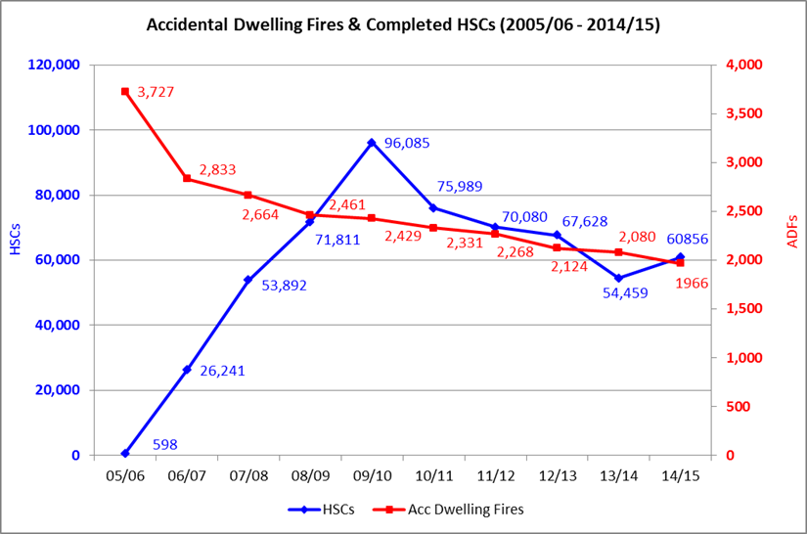
How Do We Know Prevention Works?
Notes:
1995 – ‘In The Line Of Fire’ – Report by the Audit Commission which first highlighted the potential benefits of concentrating on Prevention rather than response
1997 – ‘ Safe as Houses’ – Report from the Community Fire Safety Task Force which identified key performance measures to drive forward fire prevention
1998 – ‘Out Of The Line Of Fire’ – the governments long awaited response to ‘In The Line of Fire’ supporting the shift to prevention.
2002 – ‘IRFS, The Future of the Fire Service: reducing risk, saving lives’ the review completed by Sir George Bain recommending Modernisation of the UK Fire Service
2002/03 – ‘Industrial dispute’ – FFs asked for a 39% pay rise. They eventually achieved 16%, but many revisions to the ‘Grey Book’ came with the award, including the development of new Role Maps for Fire Fighters and Officers.
2004 – ‘Fire and Rescue Services Act 2004’ – for the first time placed a Statutory responsibility on all Fire and Rescue Authorities to do all that they could prevent fires from occurring. It also introduced a responsibility on the Fire Minister to produce a Fire and Rescue National Framework For England.

Slide 5
How Has This Helped?
670,000 Fire Safety Interventions in people’s homes
35% Reduction in the number of fires in the home
42% Reduction in the number of injuries from fire
39% Reduction in the number of fire deaths
Access homes that others can’t
Have conversations that others can’t
There’s more than one way to rescue someone
Notes:
1995 – ‘In The Line Of Fire’ – Report by the Audit Commission which first highlighted the potential benefits of concentrating on Prevention rather than response
1997 – ‘ Safe as Houses’ – Report from the Community Fire Safety Task Force which identified key performance measures to drive forward fire prevention
1998 – ‘Out Of The Line Of Fire’ – the governments long awaited response to ‘In The Line of Fire’ supporting the shift to prevention.
2002 – ‘IRFS, The Future of the Fire Service: reducing risk, saving lives’ the review completed by Sir George Bain recommending Modernisation of the UK Fire Service
2002/03 – ‘Industrial dispute’ – FFs asked for a 39% pay rise. They eventually achieved 16%, but many revisions to the ‘Grey Book’ came with the award, including the development of new Role Maps for Fire Fighters and Officers.
2004 – ‘Fire and Rescue Services Act 2004’ – for the first time placed a Statutory responsibility on all Fire and Rescue Authorities to do all that they could prevent fires from occurring. It also introduced a responsibility on the Fire Minister to produce a Fire and Rescue National Framework For England.

Slide 6
Mrs Smith
Mrs Smith dies as a result of a fire in her home
Fire involves cooking
Historical approach
What are the real issues
Notes:
1995 – ‘In The Line Of Fire’ – Report by the Audit Commission which first highlighted the potential benefits of concentrating on Prevention rather than response
1997 – ‘ Safe as Houses’ – Report from the Community Fire Safety Task Force which identified key performance measures to drive forward fire prevention
1998 – ‘Out Of The Line Of Fire’ – the governments long awaited response to ‘In The Line of Fire’ supporting the shift to prevention.
2002 – ‘IRFS, The Future of the Fire Service: reducing risk, saving lives’ the review completed by Sir George Bain recommending Modernisation of the UK Fire Service
2002/03 – ‘Industrial dispute’ – FFs asked for a 39% pay rise. They eventually achieved 16%, but many revisions to the ‘Grey Book’ came with the award, including the development of new Role Maps for Fire Fighters and Officers.
2004 – ‘Fire and Rescue Services Act 2004’ – for the first time placed a Statutory responsibility on all Fire and Rescue Authorities to do all that they could prevent fires from occurring. It also introduced a responsibility on the Fire Minister to produce a Fire and Rescue National Framework For England.

Slide 7
Lifestyle and Other Risk Factors?
Notes:
1995 – ‘In The Line Of Fire’ – Report by the Audit Commission which first highlighted the potential benefits of concentrating on Prevention rather than response
1997 – ‘ Safe as Houses’ – Report from the Community Fire Safety Task Force which identified key performance measures to drive forward fire prevention
1998 – ‘Out Of The Line Of Fire’ – the governments long awaited response to ‘In The Line of Fire’ supporting the shift to prevention.
2002 – ‘IRFS, The Future of the Fire Service: reducing risk, saving lives’ the review completed by Sir George Bain recommending Modernisation of the UK Fire Service
2002/03 – ‘Industrial dispute’ – FFs asked for a 39% pay rise. They eventually achieved 16%, but many revisions to the ‘Grey Book’ came with the award, including the development of new Role Maps for Fire Fighters and Officers.
2004 – ‘Fire and Rescue Services Act 2004’ – for the first time placed a Statutory responsibility on all Fire and Rescue Authorities to do all that they could prevent fires from occurring. It also introduced a responsibility on the Fire Minister to produce a Fire and Rescue National Framework For England.

Slide 8
Fire and Health
CFOA Strategic Health Lead
CFOA Strategic Health Group
Fire and Health Summit, April 2015
Fire and Health Project Group
  Consensus Statement
  Safe and Well Principles
  Develop Training
  Develop Guidance
PHE Winter Pressures Pilot
  Reduce Excess Winter Deaths

Slide 9


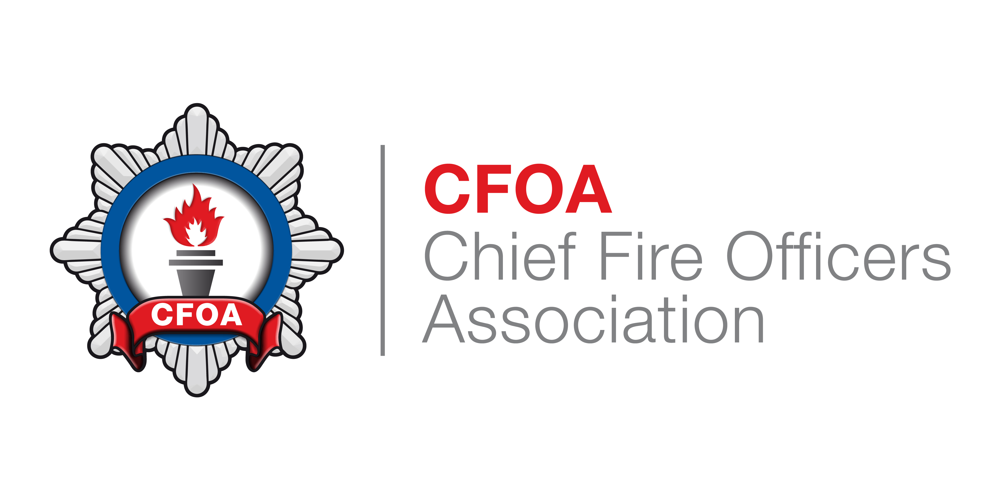

CFOA Fire and Health Project

Slide 10
Safe and Well Principles
FRS extending its approach to safety in the home to include risk factors that impact on health and wellbeing
The content of a ‘safe and well’ visit should be co-designed and based on information regarding local risks and demand.
Shouldn’t be confined to merely signposting to other agencies, but how these risks can be mitigated or reduced during the initial visit
Wherever possible the approach adopted should be:
  A light touch health check of all individuals in the home;
  Identification of risk factors while in the home;
  Provision of brief interventions and advice;
  Provision of appropriate risk reduction equipment e.g. smoke alarms, grab rail;
  Referral to specialist advice and support where appropriate. e.g. health, local authority or voluntary organisations.

Slide 11
Safe and Well Principles
Referrals to specialist advice and support should be limited to those in need of such support
Health, local authority and third sector colleagues should support training and raising awareness of their staff, where necessary.
Consistent referral pathways into specialist services should be developed across each FRS area. The CFOA, LGA, PHE, Age UK and NHSE will agree principles and guidance to assist in achieving this.
The quality of each visit is key to ensuring that they improve quality of life outcomes and lead to reduced demand for services that can be evidenced.
The number and scope of ‘safe and well’ visits completed will be determined by the capacity within each organisation, which may differ significantly from area to area.

Slide 12
Safe and Well Visit
Fire
  Cooking
  Candles
  Electrical Equipment
  Portable heaters and open fires
  Escape plans
Health
  Winter Warmth
  Extreme weather events
  Weight
  Mobility
  Falls
  Frailty
  Provision of clinical and other equipment in the home that could increase fire risk
Mental Health
  Memory
  Learning disability
  Sensory impairment
Loneliness/Social Isolation
Smoking
E-Cigarettes
Alcohol
Drugs
Prescription medicines
Hoarding
Safety of under 5s
Employment
Home security
Consent to share information

Slide 13
Safe and Well
Safe and Well Guidance
Training
  Level 2 Mental Health First Aid
  Level 2 Improving Health Inequalities
  CCG Guidance
  Health and Social Care Guidance
  Case Studies
  Outcomes Framework

Slide 14
Other Potential
Flu Inoculations
Indicators of Type 2 Diabetes
Signposting
  Eye Screening (diabetes)
  Cancer
    Breast Cancer
    Bowel Cancer
  Aortic Aneurism
Dementia Friends
Youth Health Champions
Fire Fit
  Older People
  Childhood Obesity
Secondment from PHE to Develop Further Opportunities

Slide 15
How Can You Access This?
Chief Fire Officer’s Association
  http://www.cfoa.org.uk/
Individual Fire and Rescue Service Websites
Chief Officers
Directors of Prevention and/or Protection
Heads of Prevention

Slide 16

Questions

