Slide 1


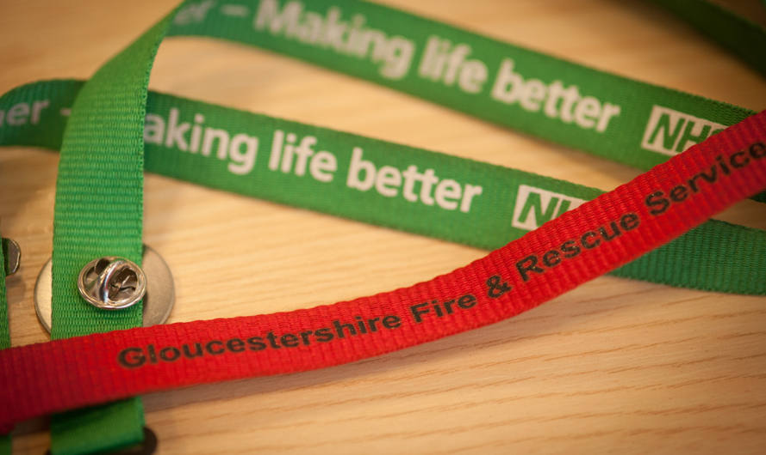
Beyond Preventing Fire: meeting the changing needs of communities, promoting Health and Wellbeing
Stewart Edgar QFSM,
Chief Fire Officer, Gloucestershire Fire and Rescue Service
And Director, Gloucestershire County Council

Slide 2




Mee
Meeting the Challenge – Together we Can
“Working Together for a Safer Gloucestershire”
^{“Working together}
we will provide the highest standard
of community safety and emergency response services
to the communities of Gloucestershire”
^{AIM 1}
^{AIM 2}
^{AIM 3}
^{AIM 4}
^{Prevention}
^{& Protection}
^{Response}
^{& Resilience}
^{People}
^{Performance}
Work with our local communities to reduce risks to life, property and the environment from fire and other emergencies
Respond promptly and effectively to deal with fires and other emergencies when they occur
^{Ensure our services}
are delivered by a professional, well equipped, highly skilled, motivated and well developed workforce which is able to work safely and whose composition reflects
^{our diverse community}
Monitor our performance to ensure we continually improve and deliver value for money

Slide 3
What is our Current Operating Environment?
Firefighter Safety and Community Safety
Protecting and improving front line outcomes is a priority
Integrated Public Sector Service – working in Partnership
Reduce costs to become more efficient whilst remaining safe and effective
Helping partners to achieve their outcomes

Slide 4























Working Together for a Safer Gloucestershire

Slide 5
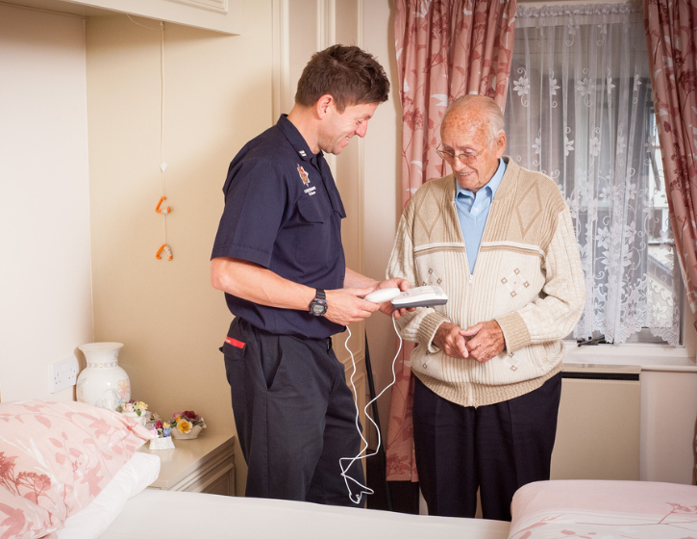


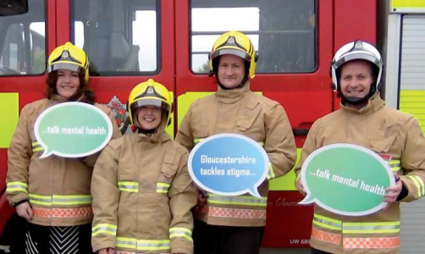
Fire as a Health and Social Care Asset in Gloucestershire
Gloucestershire Fire & Rescue Service
Telecare Responders
Community Fire Safety Group - Safeguarding
Mental Health Awareness – Specific investment of staff on Dementia Awareness
Medical Responders for SWAST

Slide 6
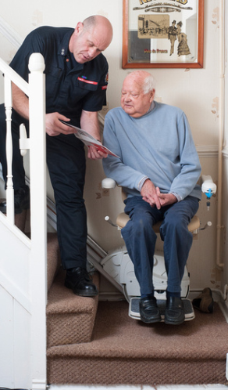
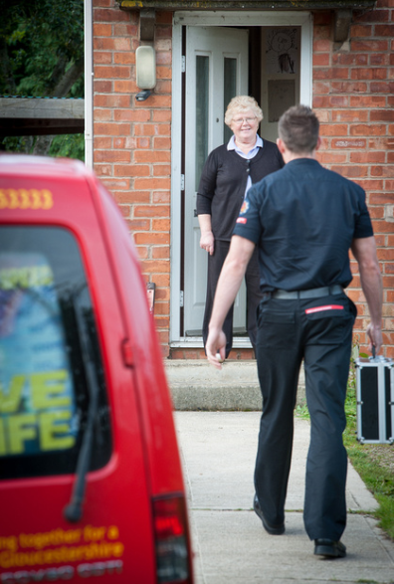
Fire and Public Health
Working with local Public Health Team to develop Firefighters to cover all aspects of a Safe and Well visit as proposed by CFOA
Training will include Making Every Contact Count
Working with local and national Public Health Teams to deliver the national Pilot relating to Winter Pressures:
For anyone over 65 years of age -
  falls prevention
  social isolation
  cold homes
  flu vaccination

Slide 7
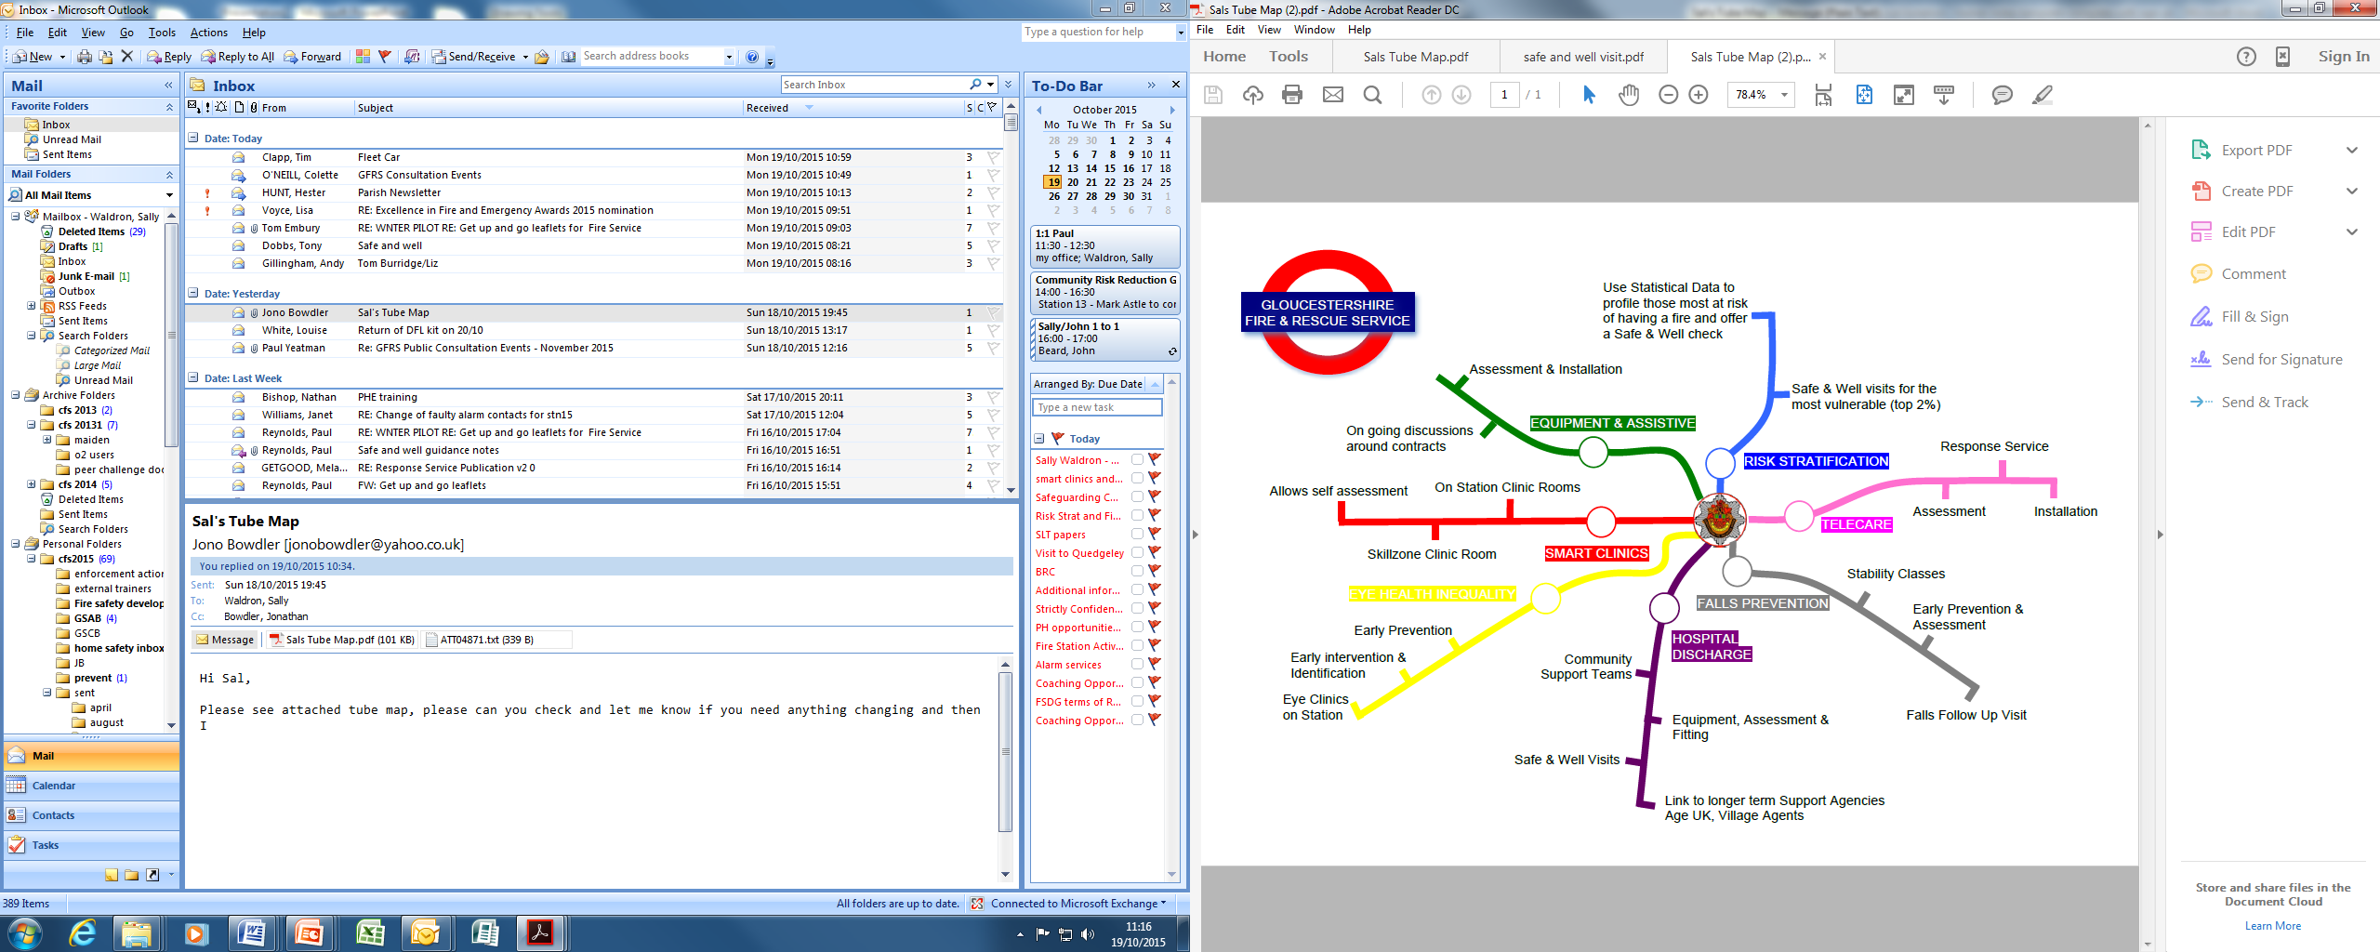
Eye Health Inequalities
Notes:
Slide one with text animation

Slide 8
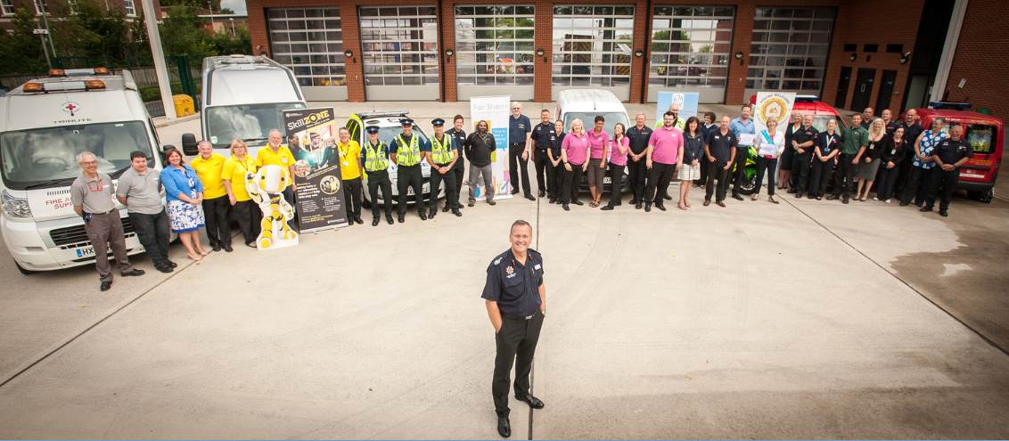
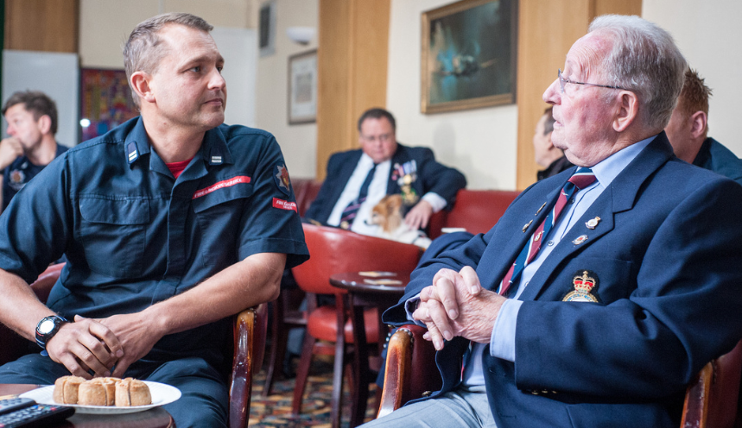
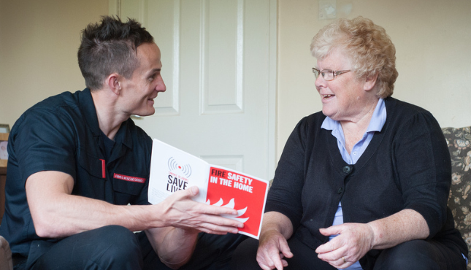

Slide 9

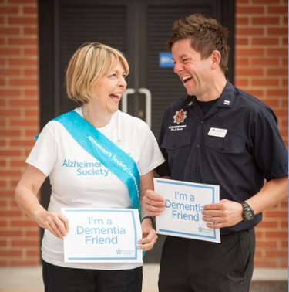

Gloucestershire Fire & Rescue Service
Tri Service Centre, Waterwells Drive, Quedgeley, Gloucester, GL2 2AX
Tel: 01452 888787
www.glosfire.gov.uk
@glosfire
@glosfirechief

