Slide 1
Adding Value Beyond Firefighting
The case for closer working
DCFO John Roberts

Slide 2
Spending review focus by Government
Promoting innovation and greater collaboration in public services
Promoting growth and productivity, including radical devolution of powers to local areas in England
Delivering high quality public services such as the NHS
Promoting choice and competition
Driving efficiency and VfM across the public sector
...Legislative duty to collaborate (2017)

Slide 3
“Its a sad fact that too many people in this country die in fires and the number of fires is currently increasing each year. This cannot be right.
The new emphasis must be on the prevention of fire, rather than the methods of dealing with fire after it has started. The approach should be grounded in community fire safety; the Fire Service has to engage more with the community to prevent fire.”
Bain Report 2002

Slide 4
So how did the FRS change?
1995 Audit Commission ‘In The Line of Fire’ Report Prevention agenda
1998 ‘Out Of The Line of Fire’ Report Schools educational packages & provision of home safety information
2004 Fire & Rescue Services Act Statutory duty to undertake community safety activities
2005 Funding of smoke alarms & undertaking of HFSC across UK

Slide 6
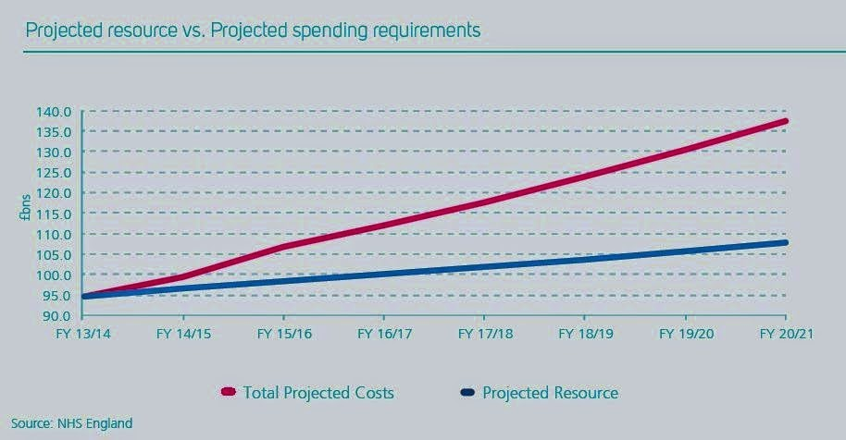
NHS Cost (Demand) vs Budget

Slide 7
National agreement between NHS England & the FRS
A new partnership to use our collective capabilities and resources more effectively to improve the quality of life for people who would benefit from brief health and wellbeing interventions in their own homes, and better coordinated public services.

Slide 8
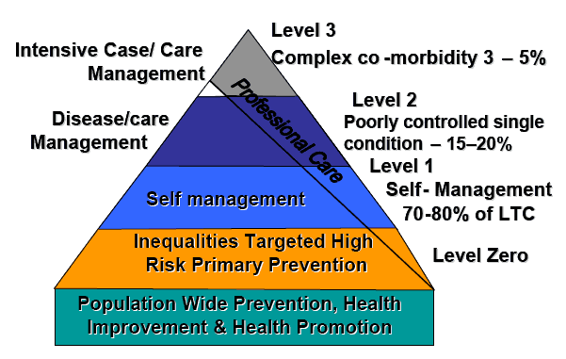
Long-term conditions – it’s a public sector problem
Notes:
You will recognise the 'pyramid of care' developed by US health provider Kaiser Permanente which identifies the population of patients with long term conditions into three distinct groups based on their degree of need. Long term conditions, or chronic diseases as they tended to be referred to, are conditions that last a year or longer, impact on a person's life, and may require ongoing care and support. The definition does not relate to any one condition, care group or age category, so it covers children as well as older people and mental as well as physical health issues.
Long term conditions become more common with age. By the age of 65, nearly two-thirds of people will have developed a long term condition. Older people are also more likely to have more than one long term condition: 27% of people aged 75-84 have two or more such conditions.
The human costs and the economic burden of long term conditions for health and social care are profound. Sixty per cent of all deaths are attributable to long term conditions and they account for 80% of all GP consultations. People with long term conditions are twice as likely to be admitted to hospital, will stay in hospital disproportionately longer and account for over 60% of hospital bed days used. Most people who need long term residential care have complex needs from multiple long term conditions.
There are clear links between long term conditions, deprivation, lifestyle factors and the wider determinants of health. People living with a long term condition are likely to be more disadvantaged across a range of social indicators, including employment, educational opportunities, home ownership and income. Someone living in a disadvantaged area is more than twice as likely to have a long term condition as someone living in an affluent area, and is more likely to be admitted to hospital because of their condition.
People living with long term conditions are also more likely to experience psychological problems. Around one in three people with heart failure and diabetes and one in five people with coronary heart disease and chronic pain will experience depression. Prolonged stress alters immunity, making illness more likely and recovery more difficult, especially for those who are already unwell.

Slide 9
Joining Up Public Services
Jacquie White, NHS England Deputy Director
Common risk factors between health and fire services
  i.e. multi-morbidity, cognitive impairment, smoking, drugs, alcohol, physical inactivity, obesity, loneliness and cold homes.
250,000 people go to A&E every year as a result of falls
Over 65s 3.5x amount of hospital care of those under 65
FRS are uniquely placed to reduce some of the risk in communities through high levels of:
Public trust
Satisfaction
Confidence
Unique access to 670,000 vulnerable people p.a.
Of which 20,000 in South Yorkshire through Safe & Well checks.

Slide 10
Hip Fractures in South Yorkshire
People age 65+ (rate per 100,000)
Notes:
In 2014/15:
1,497 people aged 65+ fell and fractured a hip in South Yorkshire
Of those, 1065 were aged 80+
The rate of hip fractures across South Yorkshire is statistically similar to the England average in Barnsley, Rotherham and Sheffield but is significantly worse than the England average in Doncaster.
Hip fractures are one of the most serious complications that can arise from a fall. Many more people aged 65+ will have fallen over the same time period in South Yorkshire and sustained other injuries, or been unable to get up without help.
People may fall several times before sustaining a serious injury, so intervening early is key

Slide 11
What do things cost us?
Fire Death - £1,650,000
Severe Injury - £185,000
Hip replacement - £10,000
Deliberate fire - £6,412
Anti-social behaviour - £648
A&E attendance - £133
Source: Cost benefit analysis guidance for local partnerships – HM Treasury April 2014

Slide 12
A solution for South Yorkshire?
The key is early identification of those at risk!
Community Risk Intervention Team(s), can include
Holistic service to support independent living,
HSC, falls prevention and recovery service
Installation of safety equipment including grab rails and security measures and monitoring equipment
Health and Wellbeing advice
Responding to Cat 1 & 2 medical emergencies
Breaking in to support medical interventions

Slide 13
“The secret of change is to focus all of your energy, not on fighting the old, but on building the new.”
Socrates

