Slide 1
Reaching Older People Through Partnership
Claire Cawkwell
Optimeyes Project Manager
RNIB
Notes:
This training has been developed by RNIB and its local society partners on Optimeyes. It is intended as guidance only and RNIB can accept no liability in regards to the advice given within this workshop.

Slide 2
What is ‘Optimeyes’?
Older People (over 50) project funded by Big Lottery’s Reaching Communities Fund
To identify and provide support to older people living with sight loss
Raise awareness of eye health issues
Provide advice information and guidance to people ‘at risk’ of sight loss

Slide 3
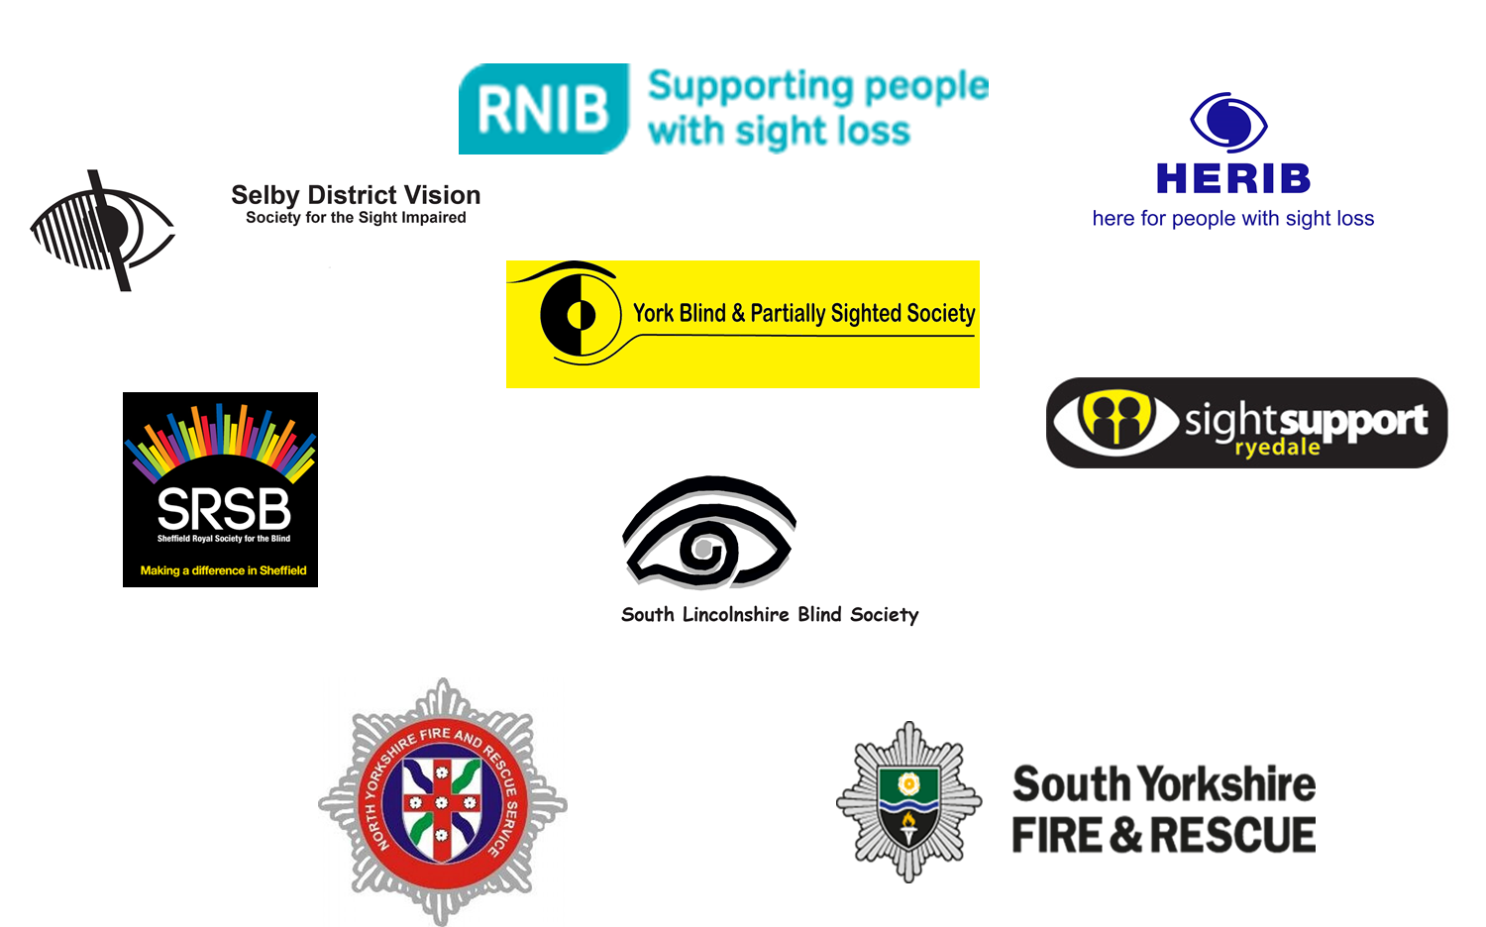

Slide 4
Why we are doing this
People over the age of 85 increasing the most.
In 2010 there were 1.7 million more people over the age of 65[1].
Sight loss is linked to age; the older you are the more likely you are to be living with sight loss [2].
There are many people living with undiagnosed sight loss

Slide 5
What the Stats Tell Us
Approx. 2 Million people over 65 are living with sight loss in the UK [3]
This affects
1 in 5 over 75s
1 in 2 over 90s [4]
50% of sight loss may be preventable with treatment or correctable with lenses.

Slide 6
Registration and Support
Older people may be less inclined to ask for or take up offers of support
Only 26 per cent of people aged 75 and over received mobility training. [5]
Higher risk of injury and falls
Greater risk of loss of independence

Slide 7
Isolation and Loneliness
“blind and partially sighted people felt cut off from people and things around them”
one in four blind and partially sighted people rarely or never felt useful [5]

Slide 8
Day-to-day Risks of Living with Sight Loss
More accidents and burns
Might not notice
Candles still burning
Cigarette not put out properly
Tea towel left close to a gas hob
Need to consider clear escape routes

Slide 9
Falls and Sight Loss
Northamptonshire
33,255 people aged 65 or over will have a fall In 2015
2,509 will have to be admitted to hospital.
200 people aged 65 and over with visual impairment having a fall resulting in hospital admission
95 of those falls would be directly attributable to visual impairment [6]

Slide 10
Why we need to work together
24,000 people over 65 thought to be living with sight loss in Sheffield, Barnsley and Doncaster
3,477 are known to SRSB
1,579 are known to RNIB and Action for Blind People
Need for greater reach is obvious

Slide 11
Fire Service Intervention – Utilising Partnerships
Seven Optimeyes Partners
Training and referral pathways
Fire and Rescue Services
Older People
Referral
Support

Slide 12
Support Offered
Peer support
Confidence building courses
Social groups and outings
Advice and information on aids and equipment
Assistive technology

Slide 13
Case Study
Miss D (60) visited by a community safety officer. She only receives informal care from a neighbour
A heavy smoker, burn marks were visible on her carpet.
No white cane and complained of bumping in to things regularly

Slide 14
Case Study Continued
She had no aids or equipment in her home
Unaware of local support services
1-2-1 assessment of her needs from SRSB
Make appropriate referrals, provide information and advice

Slide 15
Case Study Continued
Onward referrals to mobility assessment
Aids and equipment for the home
Social and peer activities
Onward referrals to smoking cessation

Slide 16
Quotes from service users
“Without this support I would have had to give up the one I thing I live for”
“I feel supported by others in the same position….they have an understanding”
“After speaking with you I immediately binned my cigarettes, didn’t know it was linked to sight loss!”

Slide 17
How does this fit in with FRS as a health asset?
Loneliness and isolation
Falls
Smoking
“Safe and Well Checks”
Strong referral pathways
Prevention

Slide 18
Any questions?

Slide 19
References
ONS, 2012a. 2011 Census, Population and Household Estimates in the United Kingdom and Europe. Office for National Statistics.
Access Economics, 2009. Future Sight Loss UK 1: The economic impact of partial sight and blindness in the UK adult population. RNIB
Slade J, 2013a. Sight loss UK 2013. RNIB.
Living with sight loss: Updating the national picture. RNIB and NatCen, 2015

Slide 20
References continued
Slade J, and Edwards R, 2015, My Voice 2015: The views and experiences of blind and partially sighted people in the UK. RNIB
Boyce T, 2011 Falls - costs, numbers and links with visual impairment. RNIB

